Slide 1
Internet安全协议与分析
SSL/TLS协议
张保稳
26/11/8

Slide 2
问题
如何对TCP上层的通讯进行安全加固？

Slide 3
本次课程教学安排
Web 安全问题
SSL
WTLS

Slide 4
WEB 安全
Web服务器易于使用但
  正确配置比较复杂
  容易成为攻击目标

Slide 5
Web 安全问题
 | 威胁 | 后果 | 反对措施
Integrity | Modification of Data Trojan horses | Loss of Information Compromise of Machine | MACs and Hashes
Confidentiality | Eavesdropping Theft of Information | Loss of Information Privacy Breach | Encryption
DoS | Stopping Filling up Disks and Resources | Stopped Transactions
Authentication | Impersonation Data Forgery | Misrepresentation of User Accept false Data | Signatures, MACs

Slide 6
不同协议层的安全
HTTP
FTP
SMTP
HTTP
FTP
SMTP
SSL/TLS
TCP
TCP
IP/IPSEC
IP
At the Network Level
At the Transport Level
S/MIME
PGP
SET
Kerberos
SMTP
HTTP
UDP
TCP
IP
At the Application Level

Slide 7
SSL 概念
Secure Sockets Layer ：由Netscape 于1994年始创，用于加固http层安全。
Version 3 of SSL was released in 1995
  It is what we think of when we say SSL
  Slight variation became Transport Layer Security (TLS) and was accepted by the IETF in 1999
  TLS is backward compatible with SSLv3
目的是使得TCP实现可靠、端对端的服务
SSL consists of two sublayers:
  SSL Record Protocol (where all the action takes place)
  SSL Management: (Handshake/Cipher Change/ Alert Protocols)

Slide 8
SSL\TLS的安全性
TLS is used connection-oriented transport, typically TCP.
TLS可做到:
  Authentication
    以public/Private key方式來做
  Confidentiality
    利用一session key，来encode和decode资料
  Integrity
    检查MAC(Message Authentication Code)，确认是否被篡改

Slide 9
不同的SSL版本
1. SSL(Secure Socket Layer)是netscape公司设计的主要用于web的安全传输协议。这种协议在WEB上获得了广泛的应用。
2. IETF(www.ietf.org)将SSL作了标准化，即RFC2246,并将其称为TLS（Transport Layer Security），从技术上讲，TLS1.0与SSL3.0的差别非常微小。由于本文中没有涉及两者间的细小差别，本文中这两个名字等价。
3. 在WAP的环境下，由于手机及手持设备的处理和存储能力有限，wap论坛（www.wapforum.org）在TLS的基础上做了WTLS协议（Wireless Transport Layer Security），以适应无线的特殊环境。

Slide 10
SSL资料
Evolved through
  Unreleased v1 (Netscape)
  Flawed-but-useful v2
  Version 3 from scratch
  Standard TLS1.0
    SSL3.0 with minor tweaks, hence Version field is 3.1
Defined in RFC2246, http://www.ietf.org/rfc/rfc2246.txt
Open-source implementation at http://www.openssl.org/

Slide 11
体系
Record Protocol to transfer application and TLS information
A session is established using a Handshake Protocol
Handshake Protocol
Change
Cipher Spec
Alert Protocol
TLS Record Protocol

Slide 12
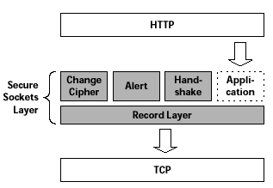
SSL在应用中的位置

Slide 13
SSL 基本过程
建立一个会话
  Agree on algorithms
  Share secrets
  Perform authentication
传输应用数据
  Ensure privacy and integrity

Slide 14
握手协议
SSL的核心协议部分
完成在传输应用数据之前进行的准备工作.
  相互认证
  协商加密算法
  建立共享密钥
The Handshake Protocol consists of messages consisting of three fields:
  Type (1 byte): Indicates type of the message. There are 10 types.
  Length (3 bytes)
  Content: The payload exchanged in each message

Slide 15
握手协议
Negotiate Cipher-Suite Algorithms
  对称密钥
  密钥交换方法
  消息摘要函数

Slide 16
握手协议基本过程
Hello 消息
证书和密钥交换
Change CipherSpec and Finished messages

Slide 17
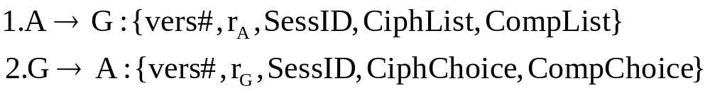
握手过程（1）
ClientHello
ServerHello
ServerCertificate
ServerKeyExchange
CertRequest
ServerHelloEnd
r_{A} is a nonce made of 4 bytes of timestamp and 28 bytes of random #. Similarly for r_{G}.
SessID: 0 if new session, else is the session ID of an existing session (and the Handshake will update parameters)
CiphList is a list of algorithms supported by the client in an order of decreasing preference (Key Exchange and Encryption Cipher)
CiphChoice: The cipher suite chosen by the Server.
ClientCertificate
ClientKeyExchange
CertVerify
ChangeCipher
Finished
ChangeCipher
Finished

Slide 18
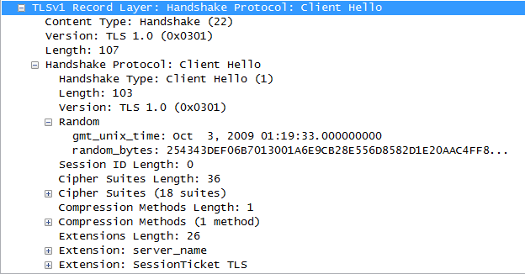
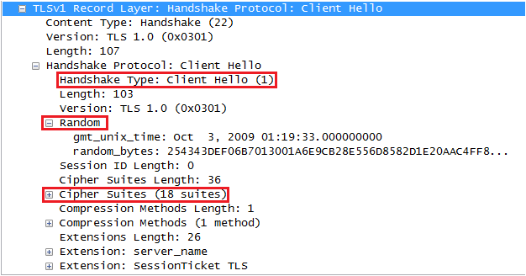
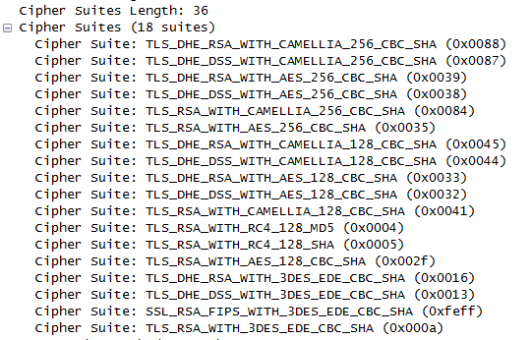
ClientHello (0x01)

Slide 19
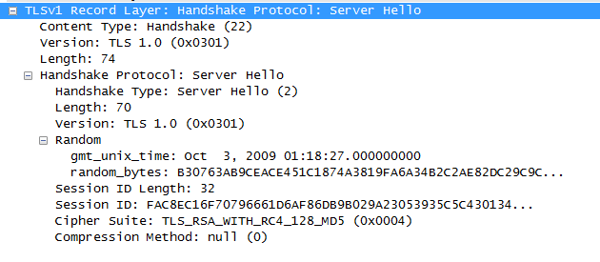
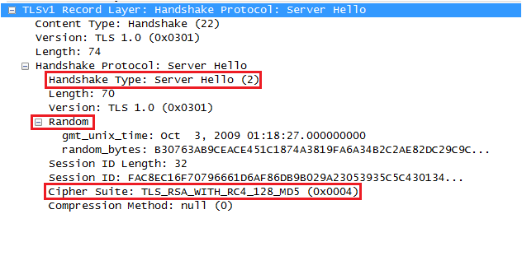
ServerHello (0x02)

Slide 20
握手过程（2）
服务器认证和密钥交换
  Server begins by sending its X.509 cert (and associated cert chain)
  Next, a public key is sent
  Server may Request a Cert from the Client
  Server sends end round 2 message

Slide 21
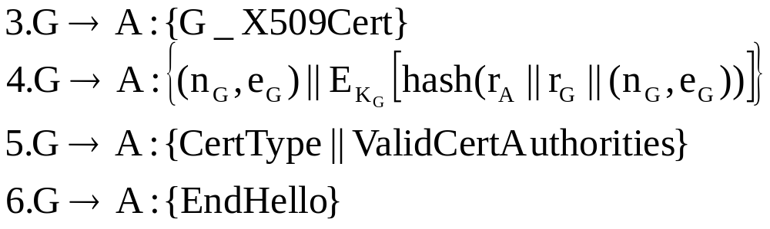
握手过程（2）
ClientHello
ServerHello
ServerCertificate
ServerKeyExchange
CertRequest
ServerHelloEnd
ClientCertificate
ClientKeyExchange
CertVerify
K_{G} is the private key, and hence E_{KG} is a signature operation by the Server
ValidCertAuthorities identifies the authorities the server will accept
ChangeCipher
Finished
ChangeCipher
Finished

Slide 22
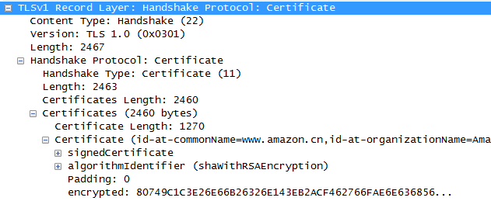
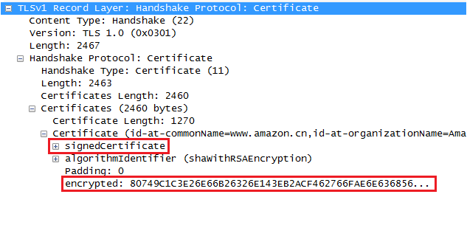
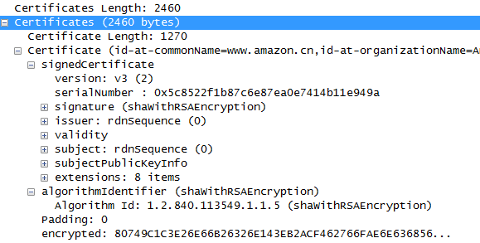
ServerCertificate (0x0b)

Slide 23
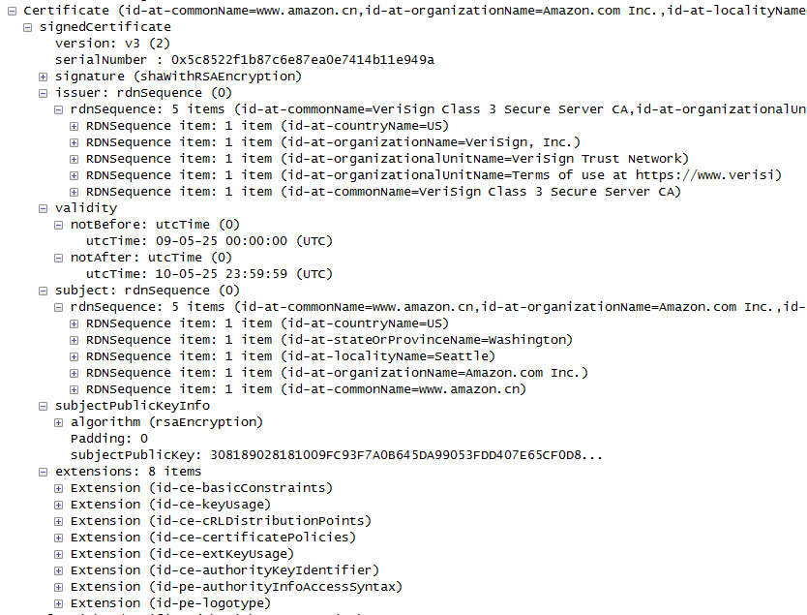
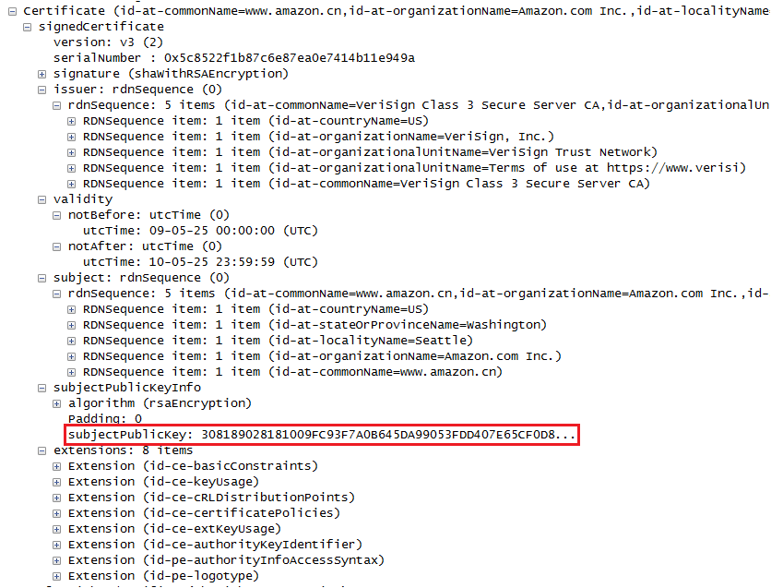

Slide 24
证书
Sequence of X.509 certificates
  Server’s, CA’s, …
X.509 Certificate associates public key with identity
Certification Authority (CA) creates certificate
  Adheres to policies and verifies identity
  Signs certificate
User of Certificate must ensure it is valid

Slide 25
证书校验问题
Must recognize accepted CA in certificate chain
  One CA may issue certificate for another CA
Must verify that certificate has not been revoked
  CA publishes Certificate Revocation List (CRL)

Slide 26
server key exchange message
The server key exchange message is sent by the server only when the server certificate message (if sent) does not contain enough data to allow the client to exchange a premaster secret.

Slide 27
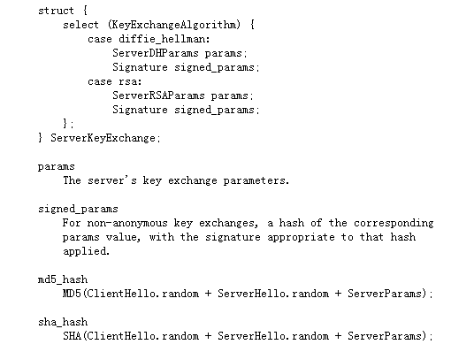

Slide 28
握手过程（3）
客户机认证和密钥交换
  Client verifies that the Server’s Cert is valid, and checks that parameters sent are valid
  If a cert was requested, then the Client sends one
  Server generates a PreMasterSecret s_{PM}

Slide 29
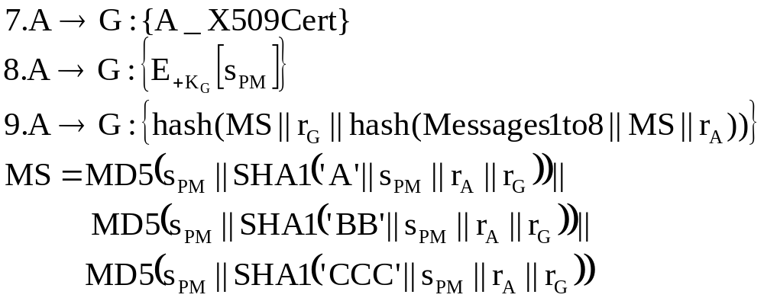
握手过程（3）
ClientHello
ServerHello
ServerCertificate
ServerKeyExchange
CertRequest
ServerHelloEnd
ClientCertificate
ClientKeyExchange
+K_{G} is the public key, and hence E_{+KG} is a encryption using the public key gained from the certificate
Messages1to8 is the concatenation of first 8 messages
MS is master secret and Step 9 is for verification
CertVerify
ChangeCipher
Finished
ChangeCipher
Finished

Slide 30
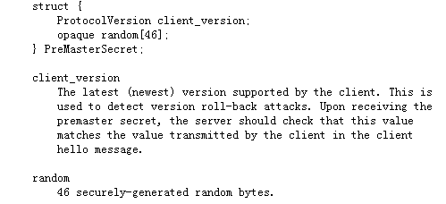

Slide 31

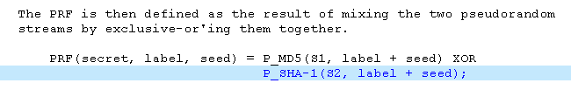
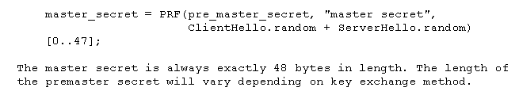
计算master secret

Slide 32
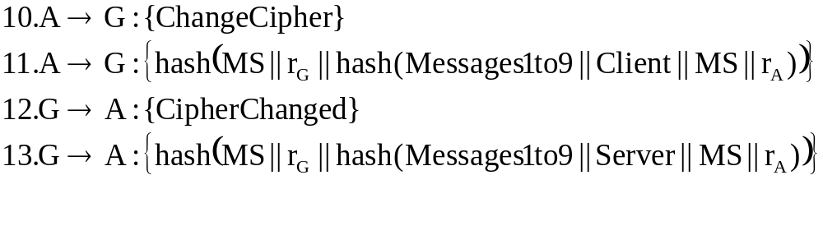
握手过程（3）
  Client tells Server to change cipher (via the Change Cipher Protocol).
  Server responds with its own changed cipher message
  Finished Message are hashes for verification

Slide 33
ClientHello
ServerHello
ServerCertificate
ServerKeyExchange
CertRequest
ServerHelloEnd
ClientCertificate
ClientKeyExchange
CertVerify
ChangeCipher
Finished
ChangeCipher
Finished

Slide 34
Change Cipher Spec
  A single byte is sent after new cipher parameters have been agreed upon . “Pending” parameters become activated.

Slide 35
SSL Alert Protocol
  Signals that unusual conditions have been encountered.
    Each message consists of two bytes. First byte is a (1) if a warning or a (2) if a fatal error. If error is fatal, the connection is terminated (other connections may continue…). Second byte says the type of error.
    Unexpected_Message: Fatal
    Bad_Record_MAC: Fatal
    Decompression_Failure: Fatal
    Handshake_Failure: Fatal
    And many more…

Slide 36
SSL加密
Master secret
  Generated by both parties from premaster secret and random values generated by both client and server
Key material
  Generated from the master secret and shared random values
Encryption keys
  Extracted from the key material

Slide 37
传输应用数据
通过握手协议建立一个SSL会话，拥有一组安全参数
一个SSL会话可以对应多个SSL连接，这些连接可以使用相同的安全参数

Slide 38
Session Security Parameters
Session Security Parameters:
  Session Identifier
  Peer Certificate: X.509v3 certificate of the peer
  Compression: Optional algorithm used to compress data
  Cipher Specs: Encryption Algorithm (3DES, AES, etc.) and hash algorithm (MD5, SHA-1)
  Master Secret: 48-byte secret shared between client and server

Slide 39
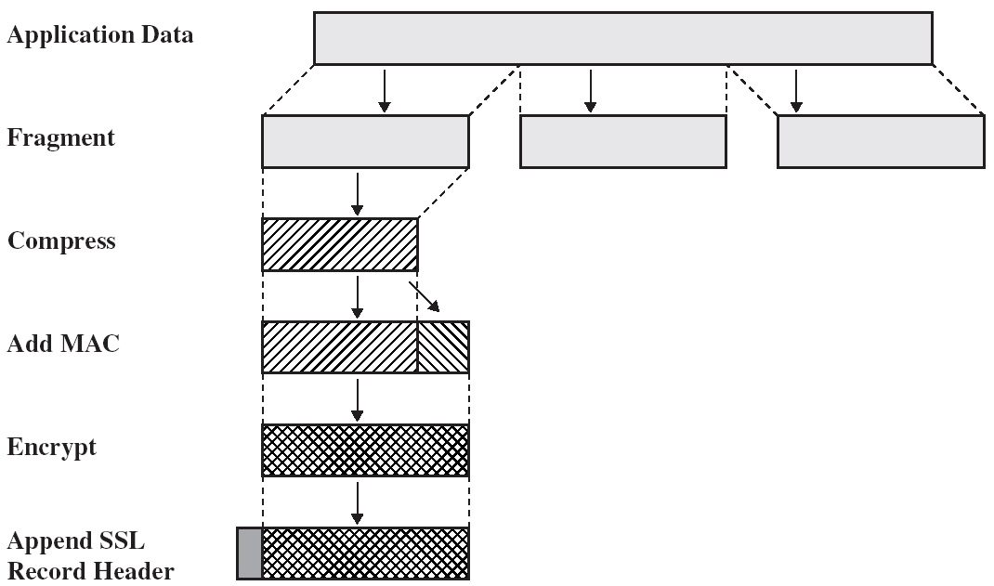
SSL Record Protocol

Slide 40
Record Header
Three pieces of information
  Content type
    Application data
    Alert
    Handshake
    Change_cipher_spec
  Content length
    Suggests when to start processing
  SSL version
    Redundant check for version agreement

Slide 41
Record Header
Max. record length 2^{14 –} 1
MAC(Message Authentication Code)
对于消息和秘密数据单向hash，难以伪造
  Data
  Headers
  Sequence number
    To prevent replay and reordering attack
    Not included in the record

Slide 42
SSL
Sessions vs. Connections
  Multiple connections within a sessions
  One negotiation/session
Session Resumption
  Through session IDs
  Clients use server IP address or name as index
  Servers use the session IDs provide by the clients
  Use of random numbers in resumed session key calculation ensures different keys
Session Re-handshake
  Client can initiate a new handshake within a session
  Use of Server Gated Cryptography (SGC) for added security

Slide 43
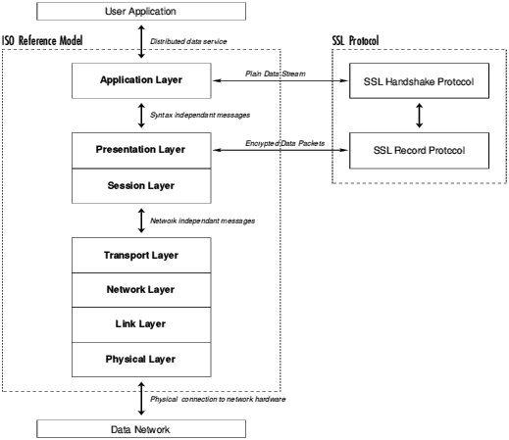

Slide 44
SSL Overhead
2-10 times slower than a TCP session
Where do we lose time
  Handshake phase
    Client does public-key encryption
    Server does private-key encryption (still public-key cryptography)
    Usually clients have to wait on servers to finish
  Data Transfer phase
    Symmetric key encryption

Slide 45
WTLS

Slide 46




WAP Gateway Architecture
Application
Servers
Wireless
Gateway
HTTP/SSL
WTLS
HTTP/SSL

Slide 47
Wireless Transport Layer Security (WTLS)
Provides security services between the mobile device (client) and the WAP gateway
  Data integrity
  Privacy (through encryption)
  Authentication (through certificates)
  Denial-of-service protection (detects and rejects messages that are replayed)

Slide 48
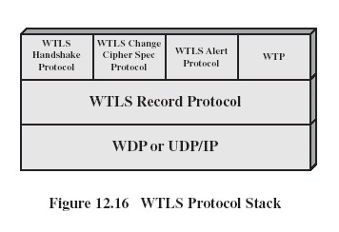
WTLS Protocol Stack

Slide 49
WTLS Record Protocol
对应用数据如下处理
  Payload is compressed
  A MAC is computed
  Compressed message plus MAC code are encrypted using symmetric encryption
  Record protocol adds a header to the beginning to encrypted payload

Slide 50
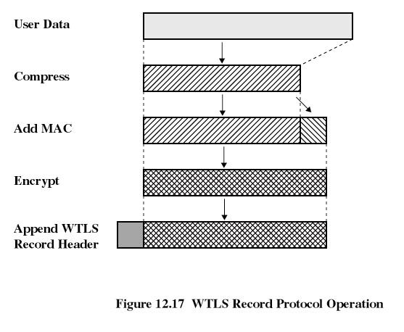

Slide 51
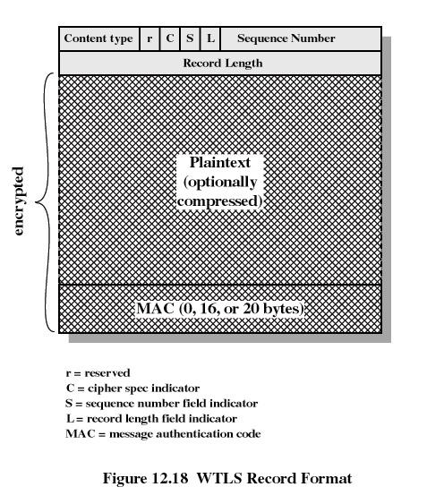

Slide 52
Alert protocol
Convey WTLS-related alerts to the peer entity
Alert messages are compressed and encrypted
A fatal warning terminates the connection (i.e. incorrect MAC, unacceptable set of security parameters in the handshake
Certificate problems usually cause a non-fatal error

Slide 53
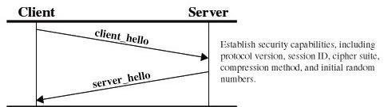
Handshake
The Handshake Protocol allows the server and client to
authenticate each other and negotiate an encryption
and MAC

Slide 54
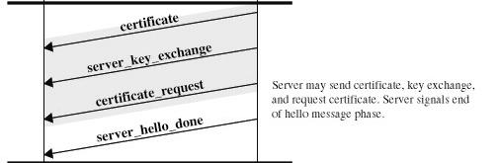
Handshake

Slide 55
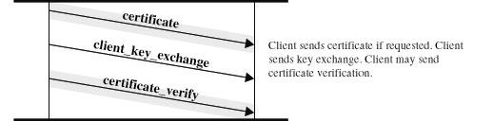
Handshake

Slide 56
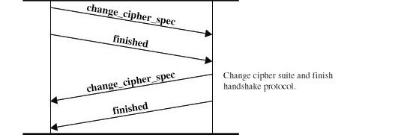
Handshake

Slide 57
WTLS VS. TLS
Datagram support ( UDP)
Expanded set of alerts
Optimized handshake – 3 levels of client/server authentication
New Certificate Format – WTLS certificates are small in size and simple to parse
Support client identities
Additional cipher suites – RC5, short hashes

Slide 58
SSL in Java
Java 1.4
The package java.security.cert contains the certificate classes
The package javax.net.ssl contains the secure socket layer implementation

Slide 59
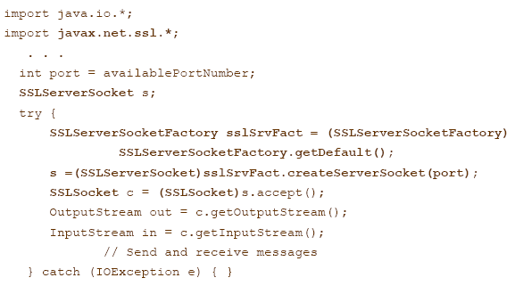

Slide 60
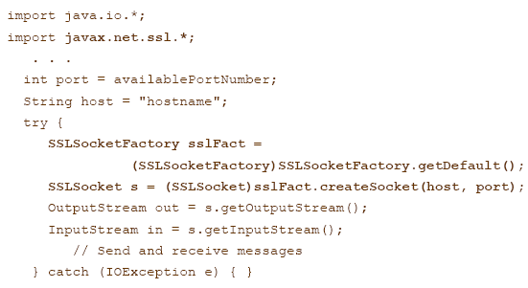

Slide 61
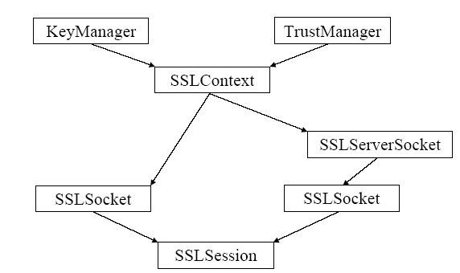

Slide 62
The end
阅读文献：
IETF:http://www.ietf.org/rfc/rfc2246.txt
Open-source implementation at http://www.openssl.org/
http://java.sun.com

